Slide 1
Employee Data Analysis using Excel
STUDENT NAME:M.SIVASHANKARAN
REGISTER NO:312212112
DEPARTMENT:B.COM(GENERAL)
COLLEGE: MAR GREGORIOS COLLEGE OF ARTS & SCIENCE

Slide 2
PROJECT TITLE
Employee Performance Analysis using Excel

Slide 3


AGENDA
Problem Statement
Project Overview
End Users
Our Solution and Proposition
Dataset Description
Modelling Approach
Results and Discussion
Conclusion
3/21/2024 Annual Review

Slide 4

PROBLEM STATEMENTv
The use of performance analytics can enable the marketing team to determine effective strategies and improve on them
These strategies consistently show poor performance should be stopped and replaced by others deemed to be more effective.
The employee better performance should be increasing our salary.

Slide 5

PROJECT OVERVIEW
Analyzing the performance of the employee by considering various factors like, gender, performance score, rating, achievements, etc. therefore, In order to identify for the trends and patterns of different categories of employee is like high, medium, low.

Slide 6

WHO ARE THE END USERS?
Manager
Employee
Employer
Human resources (HR)
Managing director (MD)
Organization

Slide 7

OUR SOLUTION AND ITS VALUE PROPOSITION
Conditional formatting is used for highlight the missing value, because identifying for the blank cells.
Filtering is the process of removing the missing cells.
formula is calculate for the employee performance level, because which employer performance high and low level rating.
A pivot table is a interactive way to quickly summarize a large amount of data.
A graphical display of categorical data that is used to show trendlines over a time.

Slide 8
Dataset Description
employee dataset – Kaggle
26 features
9 features
Employee ID – number
Employee name – text
Business unit – text
Employee status – text
Gender – male/female
Employee rating – number
Performance- text

Slide 9

THE "WOW" IN OUR SOLUTION
Performance level =IFS(Z8>=5,”VERY HIGH “,Z8>=4,”HIGH”,Z8>=3,”MED”,TRUE,”LOW”)
3/21/2024 Annual Review
9

Slide 10
MODELLING
DATA COLLECTION :
1.Data collection create or select tools for gathering data. Such
as, performance appraisal, surveys, tracking system.
2. The effectiveness of your data collection method and making
informed decisions.
FEATURE COLLECTION :
1.The feature of employee performance analysis to the data
technological advancement and evolving workplace dynamics.
2.These current trends will help organization maintain effective
and fair employee performance analysis to change work
environment and technology.
10

Slide 11
DATA COLLECTION:
1. In Microsoft excel is a powerful data connection, cleaning, and shaping technology
that is a core part of the Microsoft modern analytics suite of business intelligence
tools.
2. Data cleaning is the process of fixing or removing data that’s inaccurate, duplicated,
or outside the some errors might be hard to avoid.
PERFORMACE LEVEL:
1. The performance levels help in evaluating employee contribution, setting goals, and
identification areas for improvement.
2. they performance level and using effectively, organizations can enhance employee
development, drive better performance and achieve strategic goals.

Slide 12
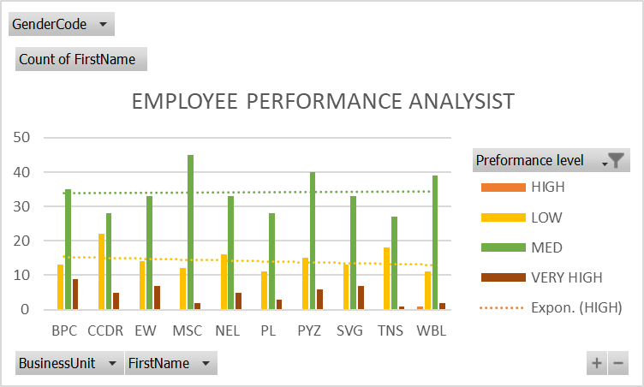
RESULTS
12

Slide 13
conclusion
Our project successfully developed by a employee performance analysis.
High performance consistently demonstrate strong skills,
dedication, and alignment with company goals to be
contributing to analysis.
Using excel for analyzing employee performance through pivot table and bar chart provides a method for gaining insights into data.

